Slide 1
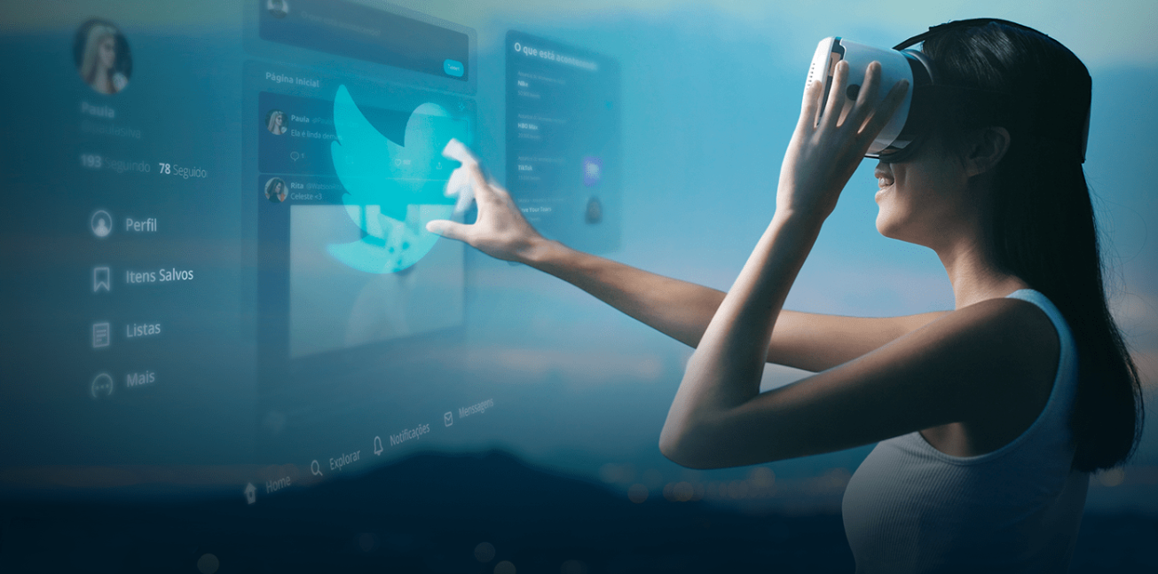
EyePay
EyePay in Augmented Reality
Developed on
Vuzix Blade
Wang Silang, Sun Yu, Jerald, Jun Leong

Slide 2
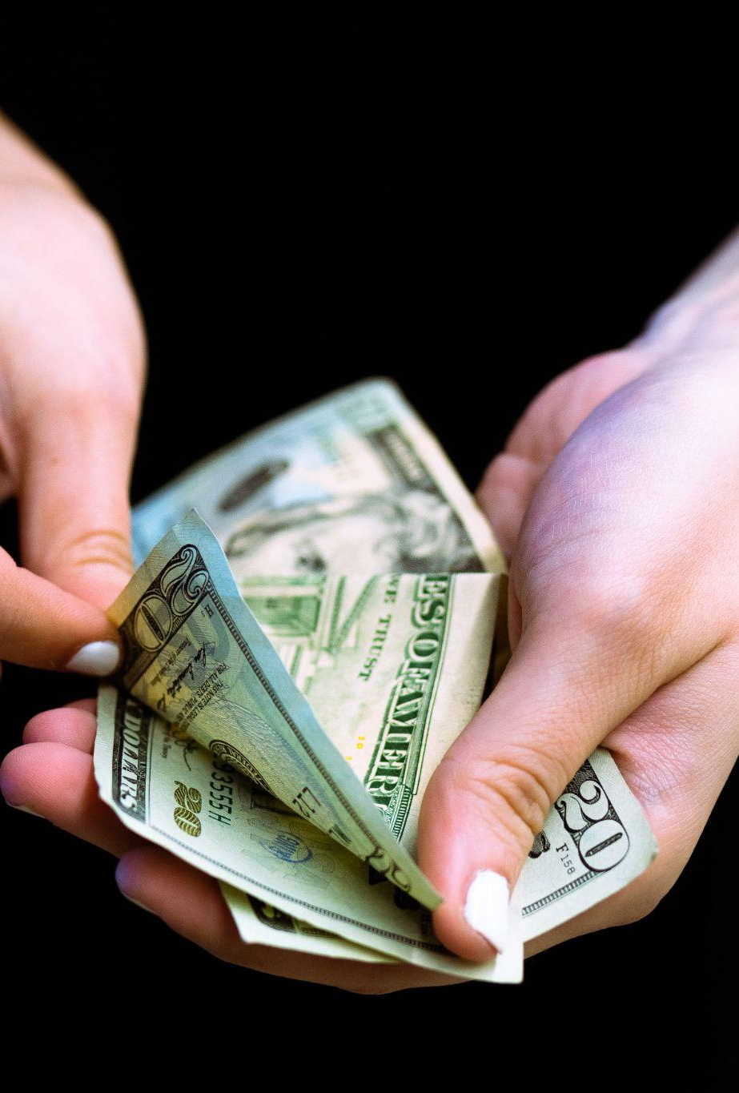
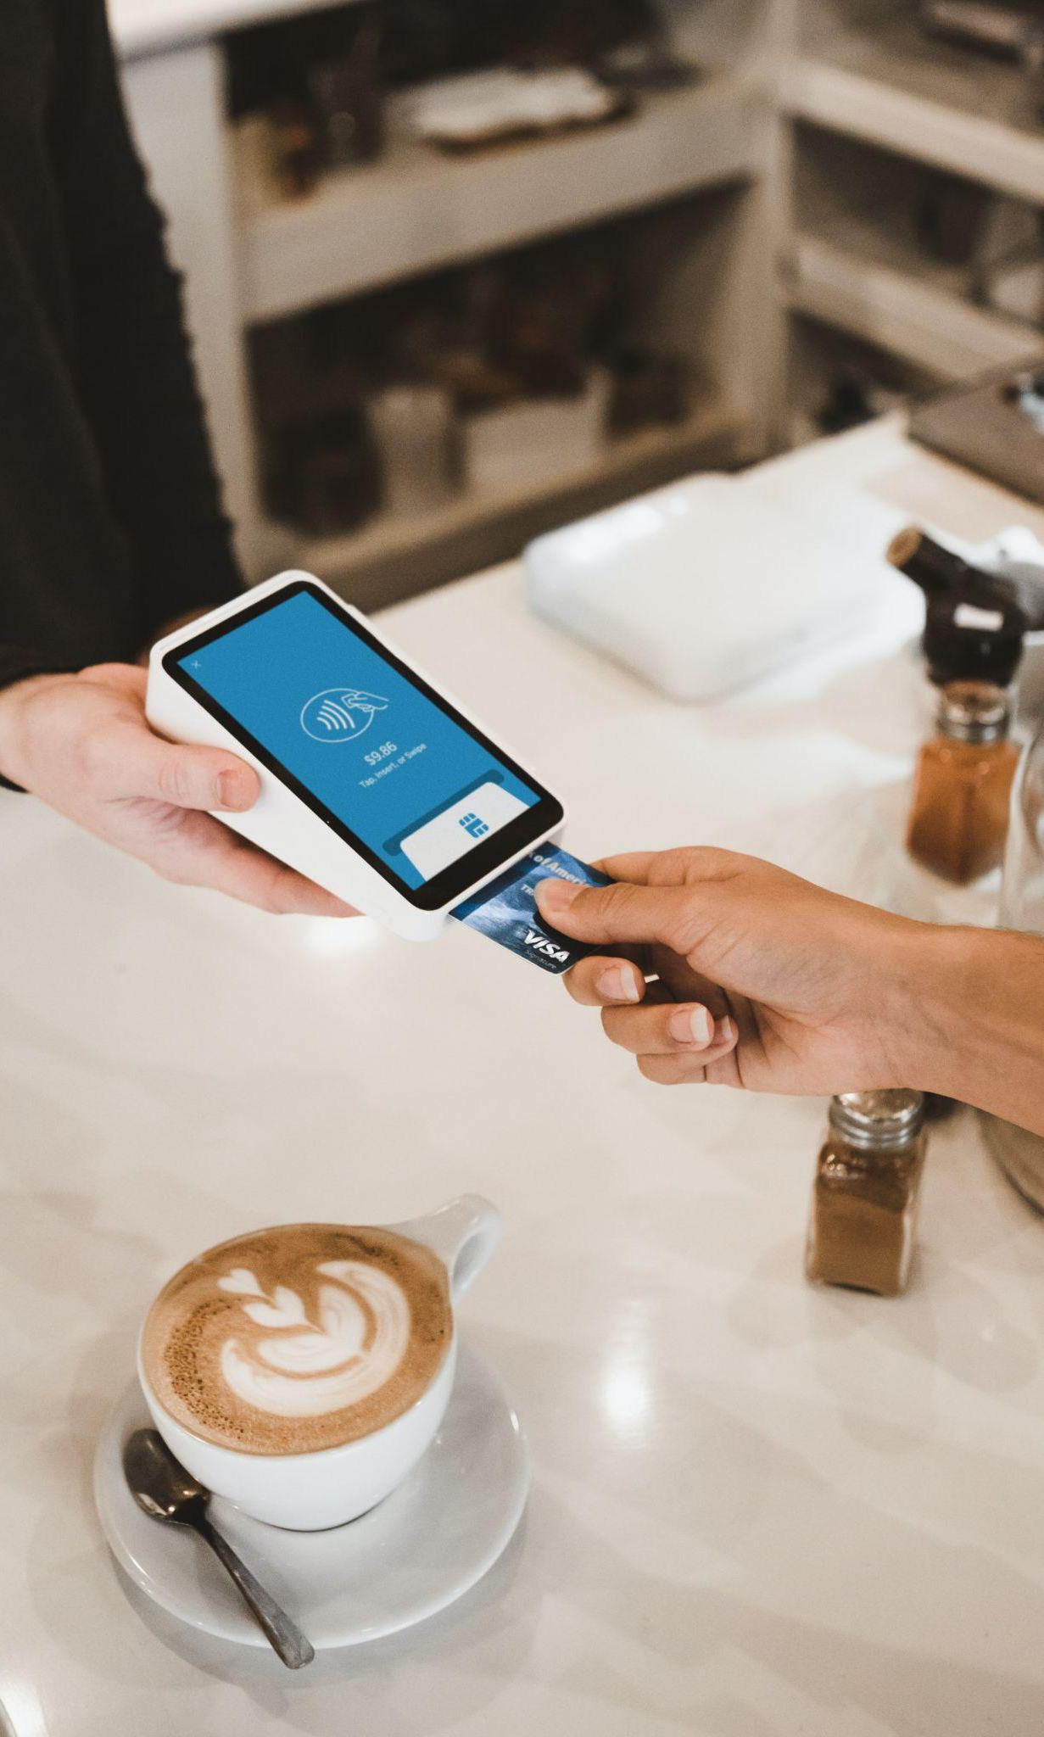
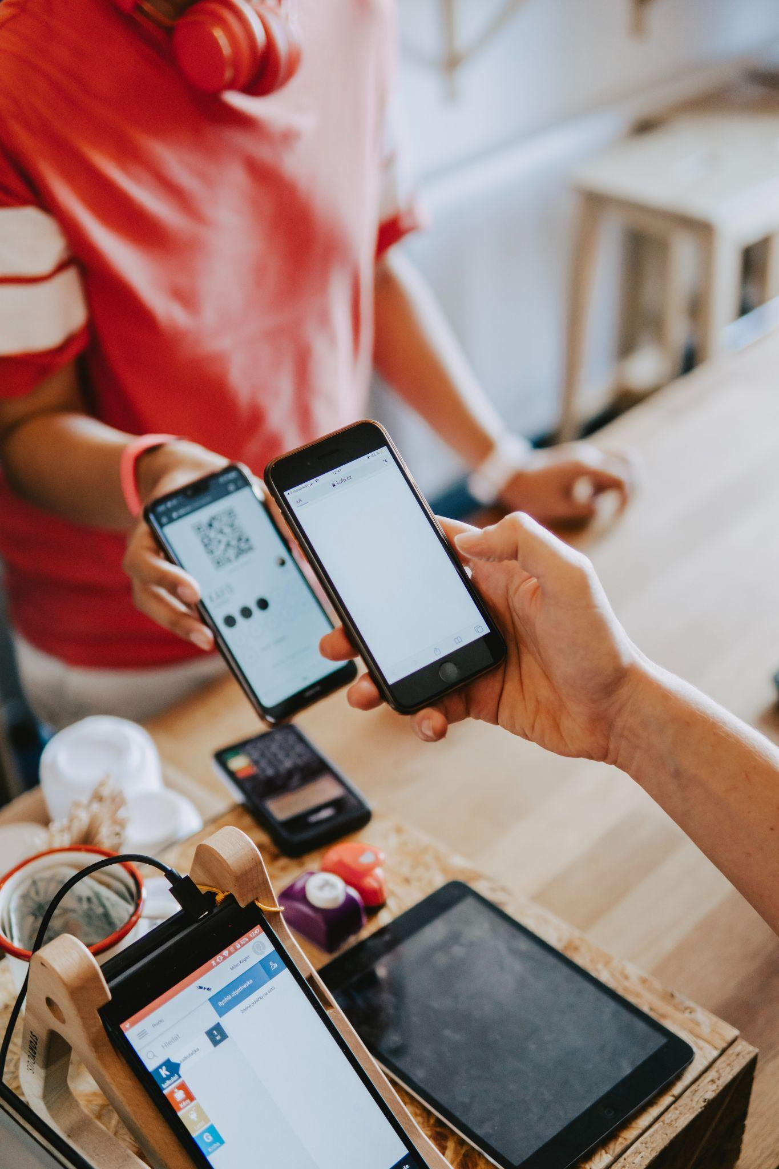
Notes:
Q: Biggest pain point for using money
A: Physical money hygiene is a problem. The change has a lot of coins also, so it becomes inconvenient to store. Mobile cashless kinda solves the problem, but takes multi steps to authenticate and officiaite the transaction like multiple clicks. Sometimes to generate the QR code, navigate oops completely missed that out
Script:
From cash to credit cards, to mobile payment that is most prevalent today, our method of transaction has undergone significant changes. However, there remains a plethora of problems with conventional methods of payment: for example the trouble of keying in personal information when shopping online on a new platform, the hassle of authentication when trying to access your mobile banking application, just to name a few

Slide 3
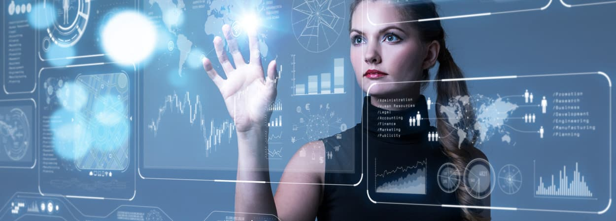
Our Product Vision
Devices should be an extension of our body, to perform actions as seamlessly and naturally as possible.
Notes:
Script:
Given all the current pain points of traditional transactional methods, we believe that with EyePay, a smart glasses application promoting seamless and intuitive transactional procedure, we will be able to introduce the next paradigm in payment practice.

Slide 4
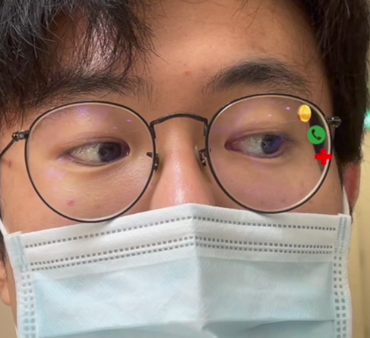
Application Features
Intuitive payment interaction
Enhanced awareness when trading
Better privacy protection
Notes:
Look at a payment marker that’s generated on the fly, synced to you smart glass
Wallet appears. Payment approval
Script:
With EyePay, we make use of “Heads-up” computing enabled by smart glasses to make the process of payment more intuitive and a lot easier. Meanwhile, close-up display of information relevant to the commodities during purchase can help users make more informed decisions, and it does a better job at protecting the users’ privacy than our smartphones with a much wider and more public display.

Slide 5
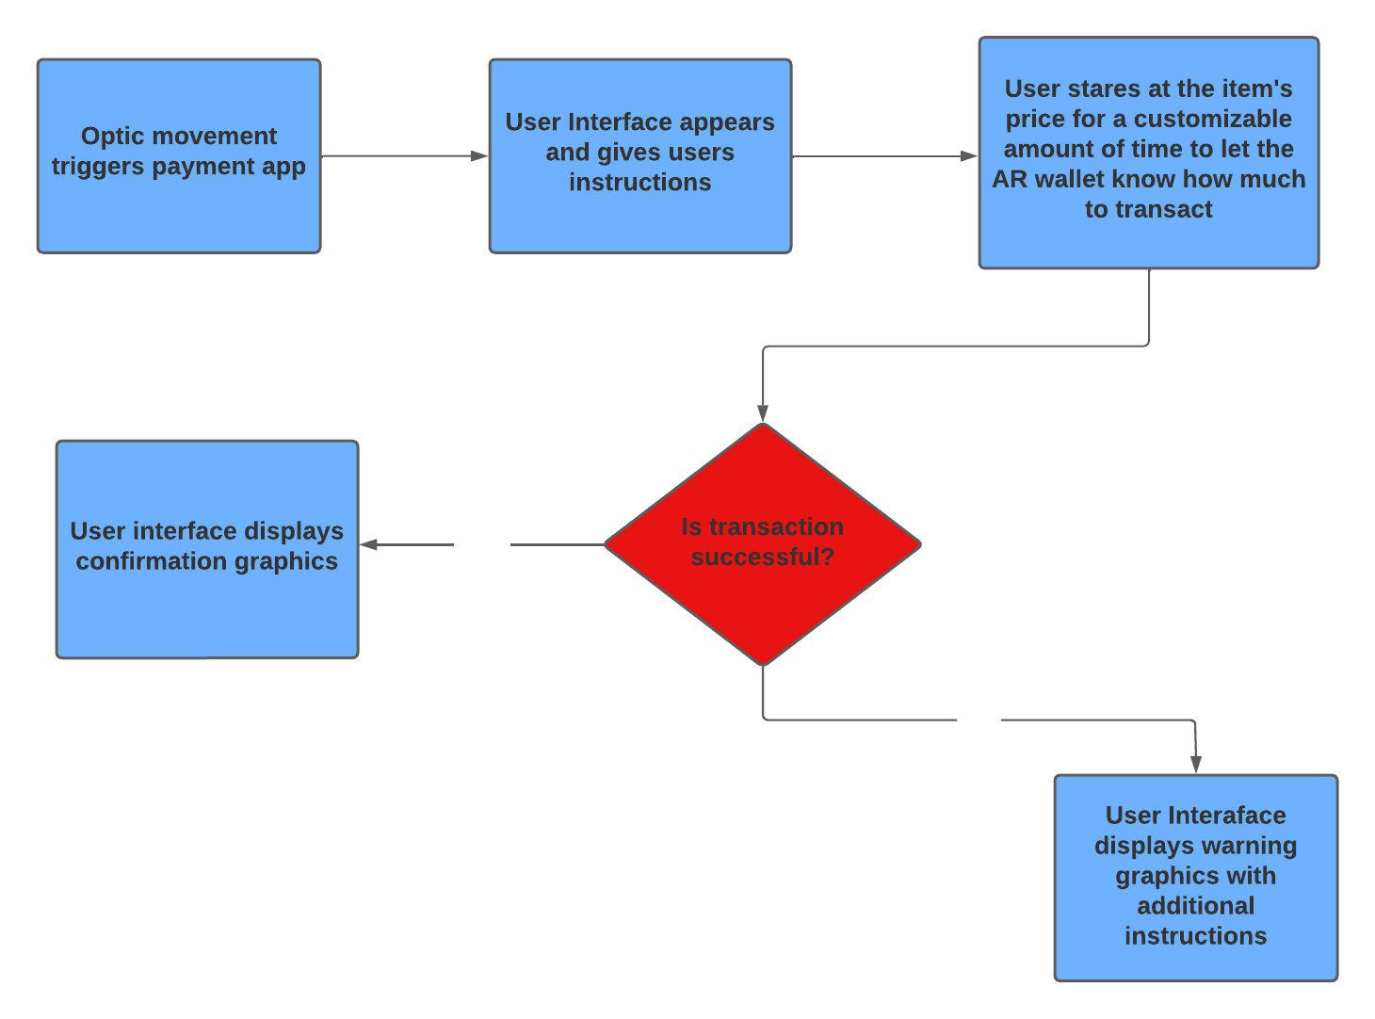
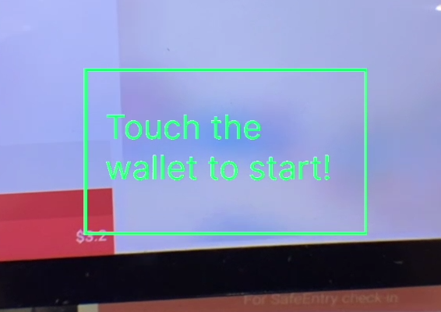
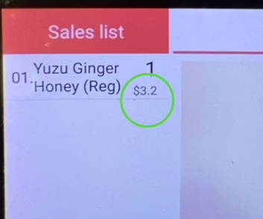
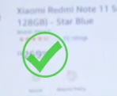
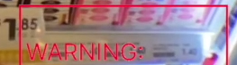
Procedure
Notes:
Script:
This is how EyePay works. In the menu page of the glasses, looking at the coin icon for a customizable period of time will launch the EyePay application. During first-time login, the system will guide the users with a textual payment tutorial. Actions like touching the avatar or nodding can trigger the payment mode, then the user will need to look at a number, representing the total sum to be paid for another period of time to confirm payment. And the glasses can achieve this through built-in eye tracking sensor. If the total sum can not be seen, the system will take in speech input for the sum to be paid. If the payment is unsuccessful, there will be additional instructions to pay again.

Slide 6
Why should I pay using EyePay?
Notes:
At this point of time, some of you may still remain unconvinced about our app’s utility. To further demonstrate EyePay’s potential, I will now explain how EyePay triumphs over traditional payment methods in three main domain.

Slide 7



Next-Gen Transactional Procedures under Different Scenarios
Eyenytime, Eyenywhere
In-store payment
Online payment
Social payment
Redefine shopping procedure
EyePay
No cashier
No queue
No problemo
Free from the hassle of keying in personal info
Direct transaction within seconds
Notes:
3 ways in which how EyePay is better than conventional methods of payment
In-store payment: redefine the shopping procedure: no cashier desk, more info on the products
Online payment: hassle-free experience without inputting bank information each time
Social payment: direct transaction to your friends within seconds
Script:
Firstly, it’s the changes it brings to the overall shopping procedures. Interactive payment avatar allows for swift payment under any settings, and with all of your payment-related information linked to your device, the glasses enable quick sign-in to different shopping platforms, and. With EyeShop, the users to pay without going to the cashiers, reducing congestions at shopping centres and making shopping a much more comfortable experience.

Slide 8


Multifaceted Human Computer Interaction
Inclusive technology
Prevent impulsive purchase
Visually impaired users can use voice recognition functionalities of the glasses to input the payment sum.
Through EEG sensors tracking the emotions of user, we hope to remind user not to engage in impulsive purchase.
Notes:
Keeping track of the user’s brain activity in a commercial setting, we hope to detect the user’s emotions through in-built EEG (electroencephalogram) sensors of the glasses, through which we can use algorithms to calculate the tendency of users to engage in impulsive purchase.
Script:
Secondly, EyePay allows for multiple forms interactions which makes our glasses a more inclusive technology. We could also make an impact on the users lifestyle by pre-empting impulsive purchase, through integrated EEG sensors into our glasses, which can keep track of our brain activities to calculate the users’ tendency to engage in impulsive purchase.

Slide 9




User-centered payment experience
Heads-up computing
More privacy
More fun
Easier to use
Natural interaction
Private screen, no face recognition
Customizable payment gesture, intuitive
Less action
Notes:
“Heads-up” computing
More natural interaction
More privacy
No face recognition, private screen
More fun
Customizable payment gesture, intuitive
Easier to use
Less action and more payment
Script:
Last but not least, EyePay adopts a much more user-centred approach when it comes to payment. With EyePay, every payment will be comfortable, safe, fun and easier than ever.

Slide 10
Limitations
Design point of view
Technical point of view

Slide 11
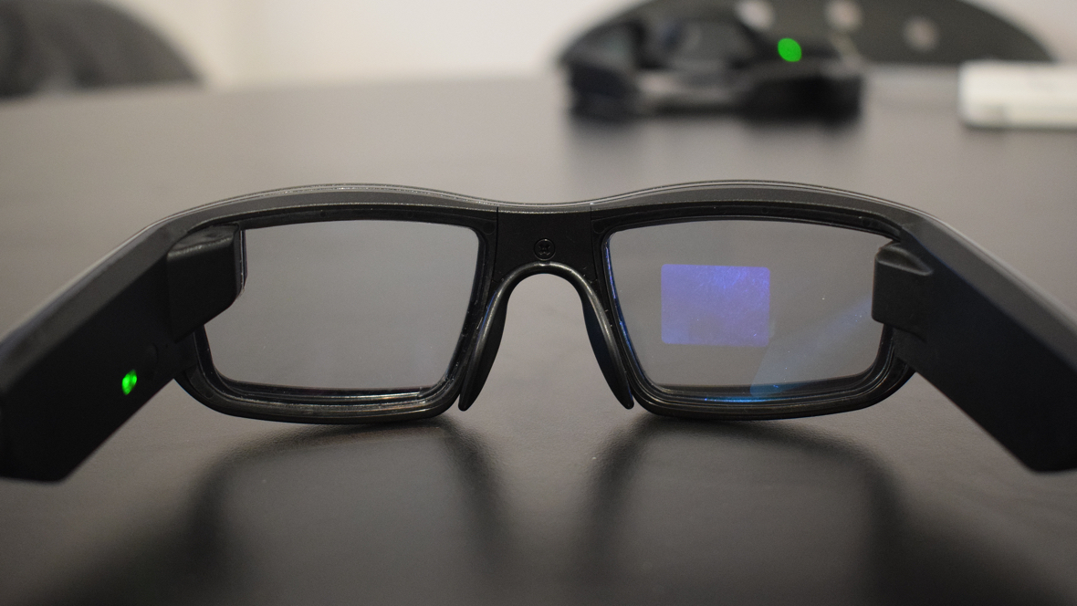
Design Limitations
Not every glass has the same controls, sensors, and features as a whole
Trust from user: lack of authentication procedure. AR glasses can be more easily hacked than phone

Slide 12
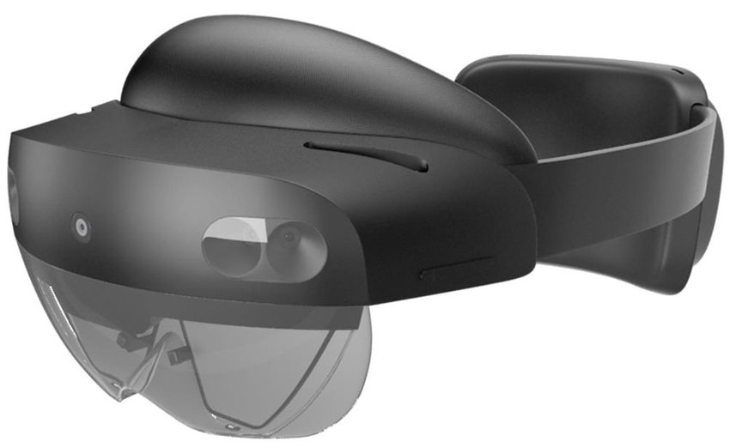
Technical Limitations
Compatibility issues with libraries
Requires time to build a secure app
Implementation of secure and easy payments are device dependent
Minimally requires HUD
Some might be more secured with computer vision (requires more powerful glasses)

Slide 13
Q&A

